Slide 1
City of Willows Banner Program
November 15, 2023 meeting of the Planning Commission

Slide 2
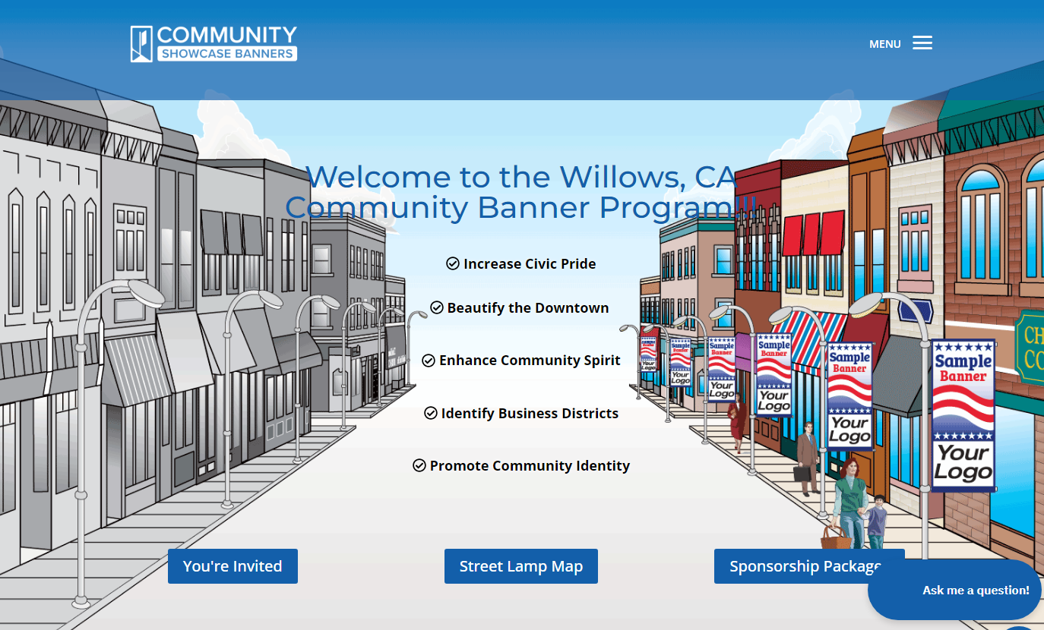

Slide 3
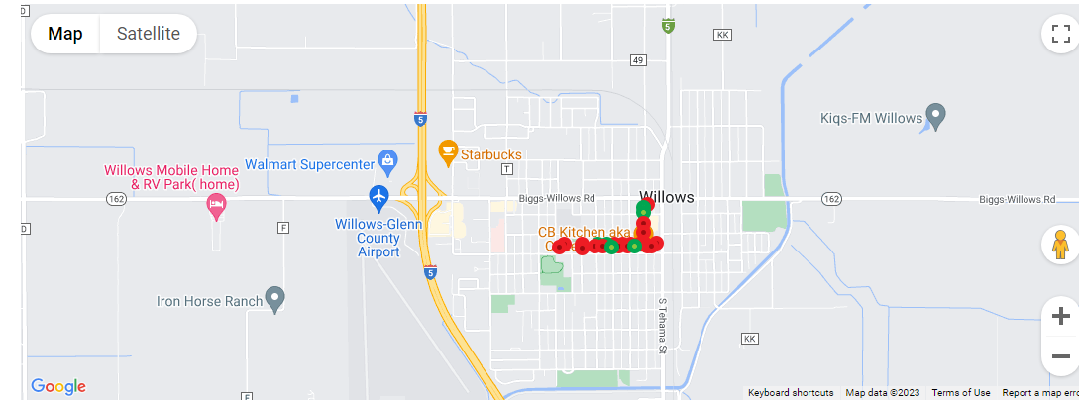
City of Willows Banner Program
November 15, 2023 meeting of the Planning Commission

Slide 4
City of Willows Banner Program
November 15, 2023 meeting of the Planning Commission

Slide 5
City of Willows Banner Program
November 15, 2023 meeting of the Planning Commission

Slide 6
City of Willows Banner Program
November 15, 2023 meeting of the Planning Commission

Slide 7
City of Willows Banner Program
November 15, 2023 meeting of the Planning Commission

Slide 8
City of Willows Banner Program
November 15, 2023 meeting of the Planning Commission

Slide 9
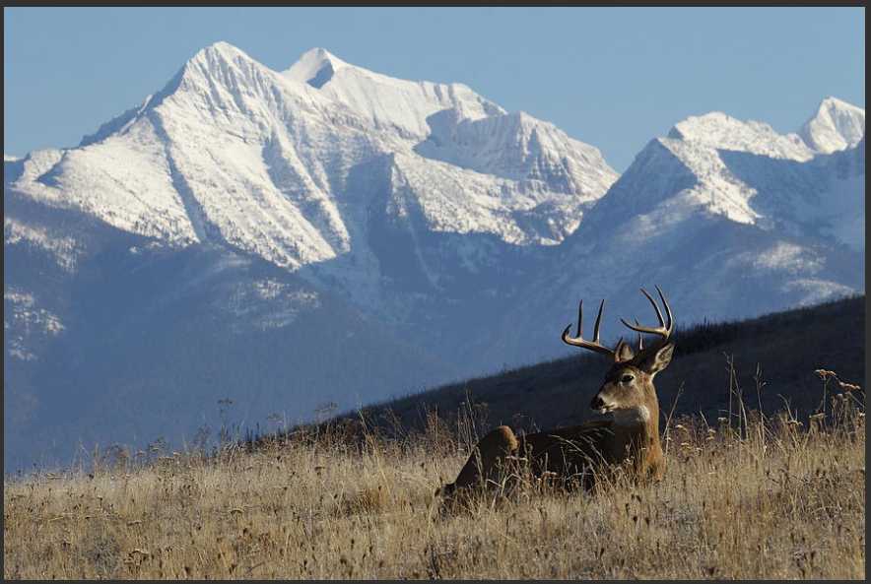
Suggested Alternatives

Slide 10
Suggested Alternatives

Slide 11
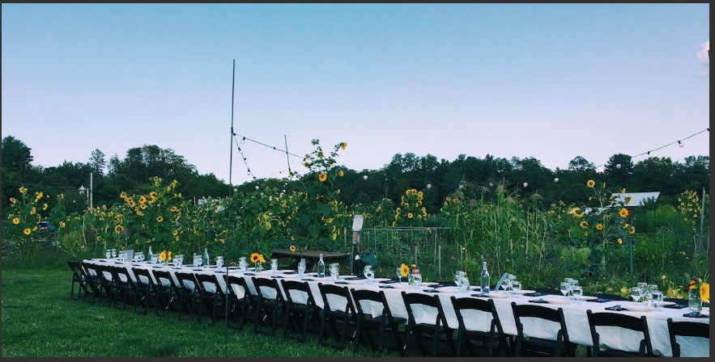
Suggested Alternatives

Slide 12
Suggested Alternatives

